Slide 1
Pronominal Anaphora Resolution
Angela Hughes, Graduate Student in Linguistics

Slide 2
What are Anaphora?
Anaphora = plural
Anaphor = singular
Simple definition:
Anaphor: An NP that obligatorily gets its meaning from another NP in the sentence.
Antecedent: The noun an anaphor refers to.
Types:
Exophoric, endophoric
Anaphora, cataphora, homophora
Sentential, bound, pronominal, one, definite
(Carnie, 2012), (Ersan & Akman, 1994).
Notes:
Sentential: “Last week, we went out to the lake near my cottage. It was fun.”
Definite: personal pronouns, possessive pronouns, and noun phrases with definite articles like “the, this, that ___.”

Slide 3
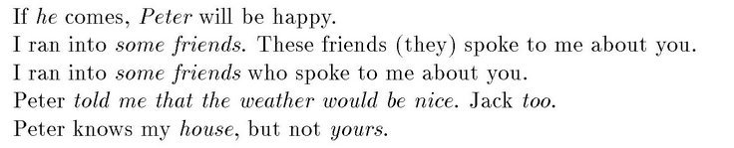
What are Anaphora?
Pronominal Anaphora
he, him, she, her, it, they/them
she/her/he/him/his/it
we/us/they/them/their
Reflexive Pronouns
Himself, herself, itself, themselves
Reciprocals
Each other
They never allow determiners or adjectival modification.
*The himself
*Big him
(Carnie, 2012), (Jurafsky & Martin, 2014).

Slide 4
Examples of Anaphora
Bill kissed himself.
Sally kissed herself.
The robot kissed itself.
She knocked her on the head with a zucchini.
The snake flattened itself against the rock.
The Joneses think they are the best family on the block.
Gary and Kevin ran themselves into exhaustion.
(Carnie, 2012),
Anaphor
Antecedent
Notes:
She knocked her on the head with a zucchini.
”her” cannot refer to the same person as “She,” because of binding theory constraints
The Joneses: how many people think “they” can be used reflexively? How many feel like this has to refer to an entity other than the Joneses?

Slide 5
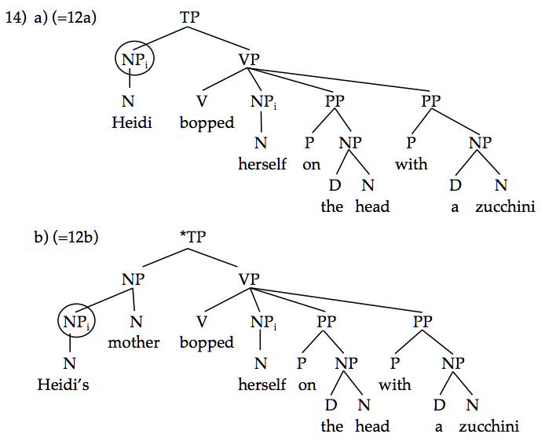
Binding Theory Constraints
Heidi_{i} bopped herself_{i} on the head with a zucchini.
[Heidi_{i}’s mother]_{j} bopped herself_{j} on the head with a zucchini.
(Carnie, 2012),
Notes:
. “She” c-commands “her” within the same clause, thus requiring that “herself” be used instead of ”her” if the two pronouns were to refer to the same individual.

Slide 6
Examples of Anaphora Gone Wrong
Anaphor
*Sally kissed himself.
*Kiss himself.
*She knocked himself on the head with a zucchini.
*Herself bopped Heidi on the head with a zucchini.
*The Joneses think himself the most wealthy guy on the block.
*Gary and Kevin ran himself into exhaustion.
?The snake flattened himself/herself against the rock.
(Carnie, 2012).
Antecedent
Notes:
There must be an antecedent, and there must be agreement in features, such as: 1. number 2. gender 3. person
4. case

Slide 7

Which NP Is the Antecedent?
Sometimes we must rely on inference and extra-linguistic knowledge to resolve the reference.
Anaphoric expression
(Ersan & Akman, 1994).
Notes:
Sometimes it’s not so obvious which noun phrase is being referenced when we say “it,” “he”, “they,” etc.
The definite NP the nurses is an anaphoric expression that has no antecedent in the preceding text.
We know that nurses are at hospitals, and that’s where you go when you have a vehicular accident.
(Ersan & Akman, 1994).

Slide 8
Which NP Is the Antecedent?
recency,
grammatical role,
repeated mention,
parallelism,
verb semantics,
selectional restrictions.
(Jurafsky & Martin, 2014).

Slide 9
Recency
(Jurafsky & Martin, 2014).

Slide 10

Grammatical Role
(Jurafsky & Martin, 2014).

Slide 11
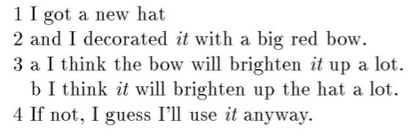
Repeated Mention
Does “it” refer to
The hat?
The bow?
(Ersan & Akman, 1994).
Notes:
In the second sentence, the subject is “the engine.”
Notice we don’t take “the highway” to the mechanic. We don’t

Slide 12
Parallelism
(Jurafsky & Martin, 2014).
Notes:
John is more salient in the grammatical role hierarchy than Jim. Nonetheless, Jim is preferred to match the pronoun ‘him.’ Similar to coordinated conjunctions or coordinated verb phrases.

Slide 13
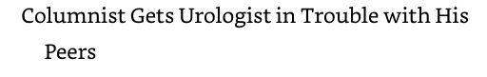
Verb Semantics
Pinker, (p. 70).
Notes:
Certain verbs appear to place a semantically oriented emphasis on one of their argument positions, which can have the effect of biasing the manner in which subsequent pronouns are interpreted. (Jurafsky)
In this case, “grammatical role” would have us guess the columnist, as the subject, gets the “his” pronoun. Indeed, it could be the columnist and the columnist’s peers conspired to get the urologist in trouble. However, the most likely takeaway is what we usually expect with X gets Y in trouble with Z, due to how the verb phrase “get the culprit in trouble with the law” usually works.

Slide 14
Selectional Restrictions
Driving what?
The car?
The garage?
(Jurafsky & Martin, 2014).
Notes:
In the second sentence, the subject is “the engine.”
Notice we don’t take “the highway” to the mechanic.

Slide 15
Algorithms
The Hobbs algorithm
Centering algorithm
Log-linear (or MaxEnt) algorithm

Slide 16
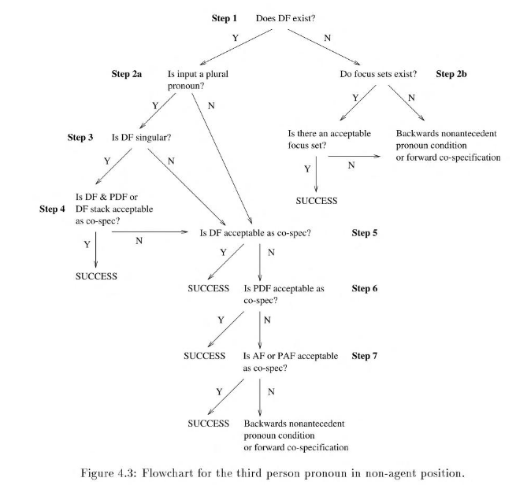
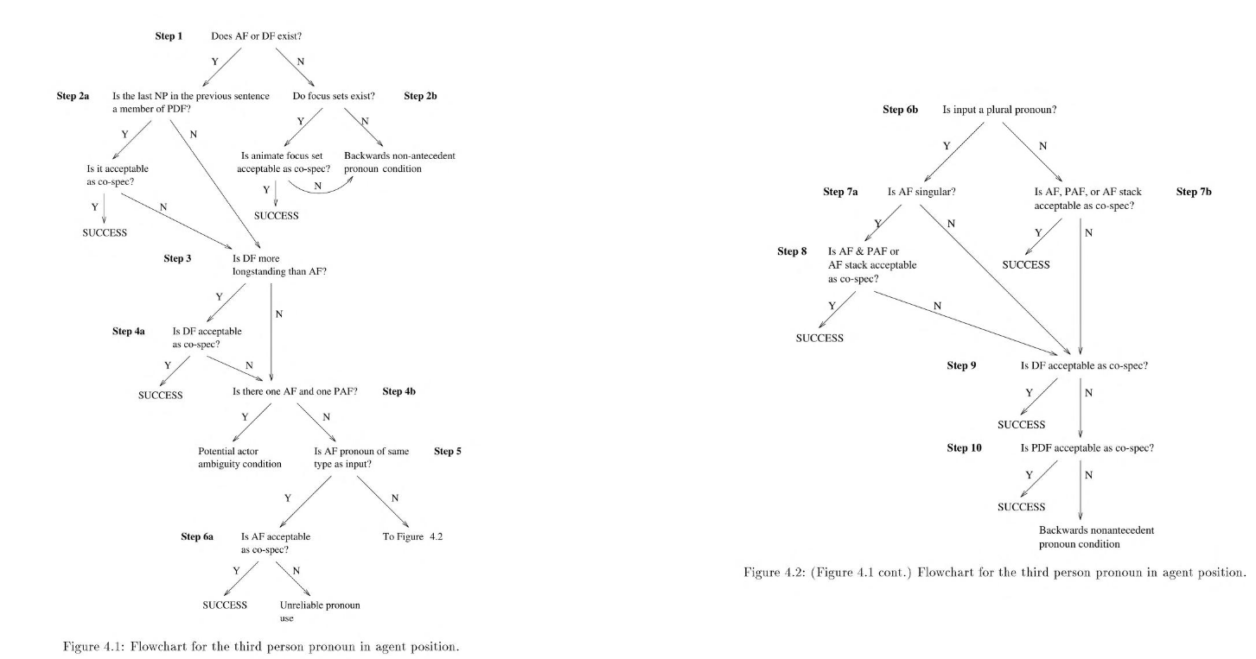
Algorithms
(Ersan & Akman, 1994).
Notes:
Flowcharts of third person pronoun in agent position
Flowchart for third person pronoun in non-agent position.

Slide 17
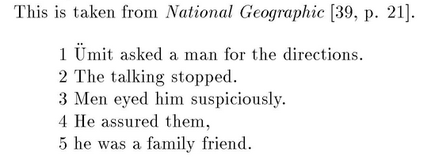
Problems for the Algorithm
Success:
“they/them” referred to ”men.”
Failure:
“he” referred to “a man.”
(Ersan & Akman, 1994).
Notes:
Focusing algorithms used by Grosz & Sidner (1986).
It incorporated elements from the Hobbs algorithm from 1978.

Slide 18

Problems for the Algorithm
Which one goes to the mechanic?
My car?
The highway?
The engine?
(Ersan & Akman, 1994).
Notes:
In the second sentence, the subject is “the engine.”
Notice we don’t take “the highway” to the mechanic.
In this case, the resolution of definite noun phrases and their co-specifications were given to the system manually, and with that help, it was able to correctly establish the current focus (CF) as my car, considering the engine to implicitly specify an element associated with my car.

Slide 19
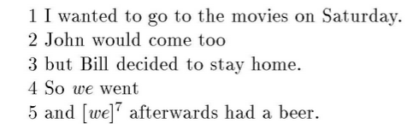
Problems for the Algorithm
Who does “we” include?
John & I?
Bill & I?
John, Bill, & I?
(Ersan & Akman, 1994).
Notes:
The more salient NP on the grammatical role hierarchy gets the reference.
It is not possible to construct a system that is 100% accurate without inferencing. It’s necessary for discourse understanding.
The algorithm needs inferencing in order to be aware of the difference between sentence 2 & 3.

Slide 20
References
Carnie, Andrew. Syntax: A Generative Introduction, 3rd Edition. Wiley-Blackwell (STMS), 09/2012.
Jurafsky, Daniel & Martin, James H. Speech and Language Processing, 2nd Edition. Pearson, 20141230.
Pinker, Steven. The Language Instinct (Harper Perennial Modern Classics) (p. 70). HarperCollins e-books. Kindle Edition.
Focusing for Pronoun Resolution in English Discourse: An Implementation
by Ebru Ersan; Varol Akman
Publication date 1994-09-07
http://arxiv.org/abs/cmp-lg/9409005v1

Slide 21
References
Computational Approach to Anaphora Resolution in Spanish Dialogues
by P. Martinez-Barco; M. Palomar
Publication date 2011-06-03
Source http://arxiv.org/abs/1106.0673v1
Resolving anaphoras for the extraction of drug-drug interactions in pharmacological documents.
by Segura-Bedmar, Isabel; Crespo, Mario; de Pablo-Sanchez, Cesar; Martinez, Paloma
Publication date 2010-04-16
Translation of Pronominal Anaphora between English and Spanish: Discrepancies and Evaluation
by A. Ferrandez; J. Peral
Publication date 2011-06-24

